Slide 1
English
Unit 2 – Sport
Monday 5th October 2026
WALT:
Read independently a range of short, simple fiction and non-fiction texts with confidence and enjoyment.

Slide 2



WALT: Read independently a range of short, simple fiction and non-fiction texts with confidence and enjoyment.
I can read a text aloud.
I can answer questions on a text.
I can write my own short piece of commentary and read it using intonation and stress correctly.

Slide 3
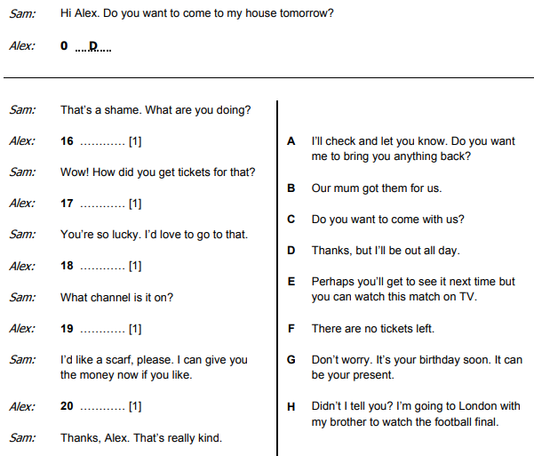
Retrieval Practice
WALT: Read independently a range of short, simple fiction and non-fiction texts with confidence and enjoyment.
H
H
E
A
G

Slide 4
Starter – What sports are being commentated on? https://www.youtube.com/watch?v=GHtIxjKPP9w https://www.youtube.com/watch?v=UmIYanq5gH8 (from 1:25) https://www.youtube.com/watch?v=fZl_LVU7a18
WALT: Read independently a range of short, simple fiction and non-fiction texts with confidence and enjoyment.

Slide 5
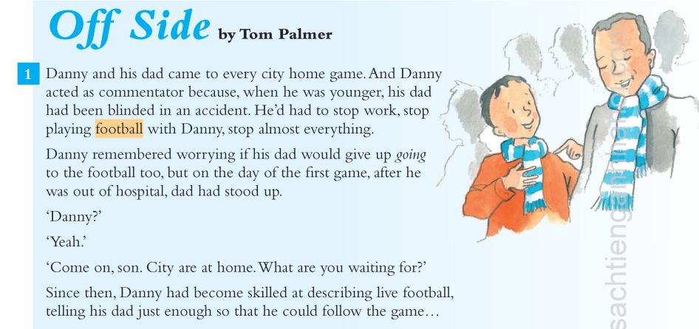
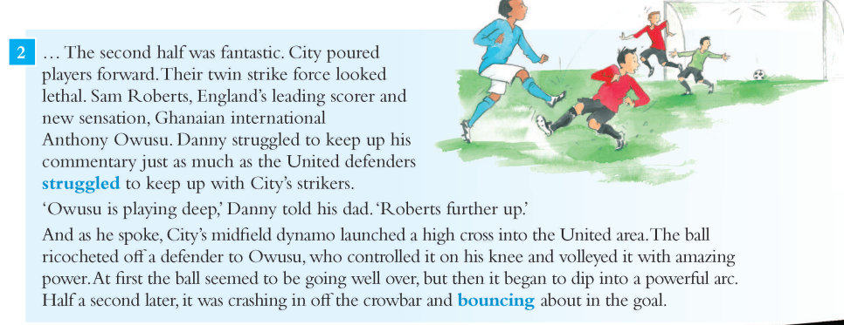
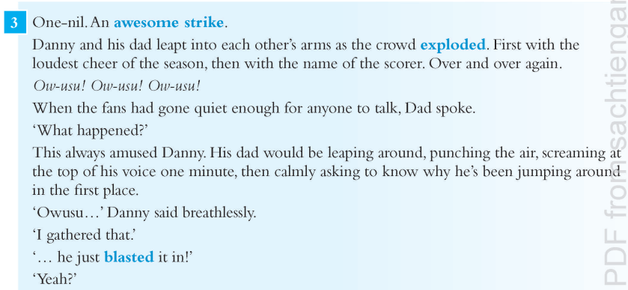
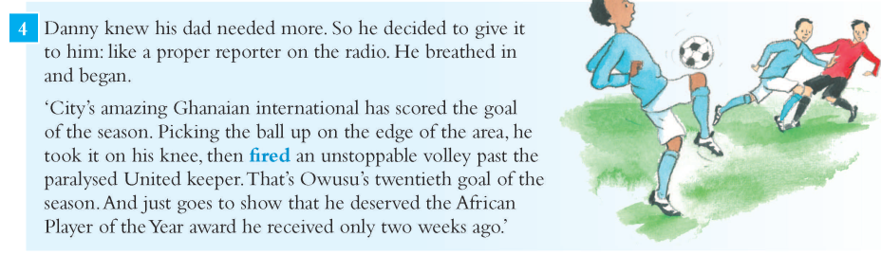
WALT: Read independently a range of short, simple fiction and non-fiction texts with confidence and enjoyment.
Read the text by yourself.
Page 36 - 38

Slide 6
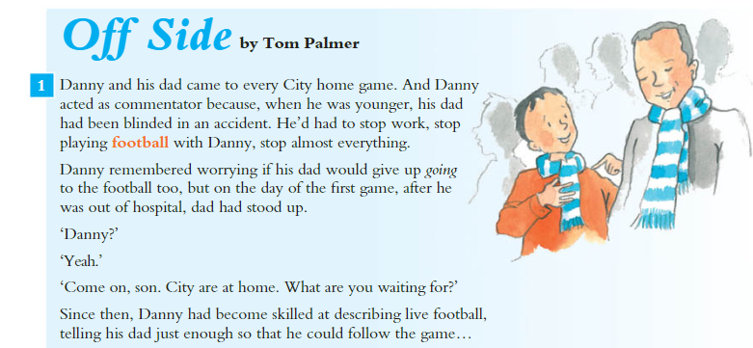
Now lets read it together.
WALT: Read independently a range of short, simple fiction and non-fiction texts with confidence and enjoyment.

Slide 7
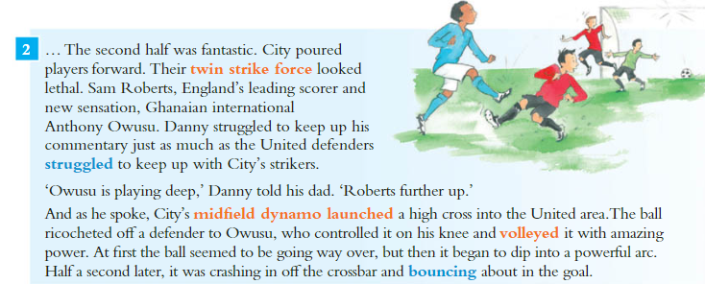
WALT: Read independently a range of short, simple fiction and non-fiction texts with confidence and enjoyment.

Slide 8
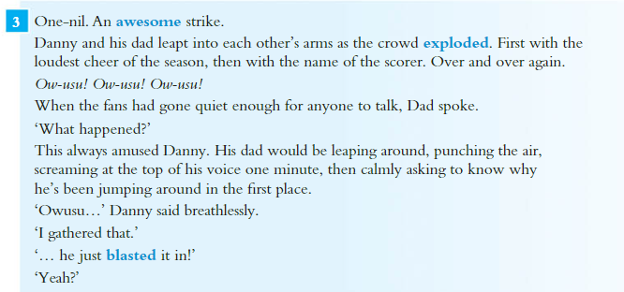
WALT: Read independently a range of short, simple fiction and non-fiction texts with confidence and enjoyment.

Slide 9
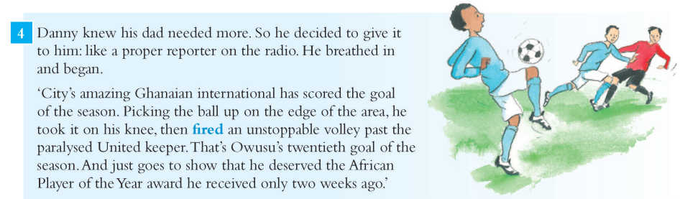
WALT: Read independently a range of short, simple fiction and non-fiction texts with confidence and enjoyment.

Slide 10
WALT: Read independently a range of short, simple fiction and non-fiction texts with confidence and enjoyment.
I do
In section two, what word describes how the players moved forward onto the ball?
We do
In section three, why did the crowd explode?

Slide 11
WALT: Read independently a range of short, simple fiction and non-fiction texts with confidence and enjoyment.
Your task
Answer the questions in your learner book.
Remember –
Carefully read the questions
Check your answers
Finished?
Answer questions 5 – 7 in your Learner Book

Slide 12
WALT: Read independently a range of short, simple fiction and non-fiction texts with confidence and enjoyment.
I can read a text aloud.
I can answer questions on a text.
I can write my own short piece of commentary and read it using intonation and stress correctly.

